Slide 1
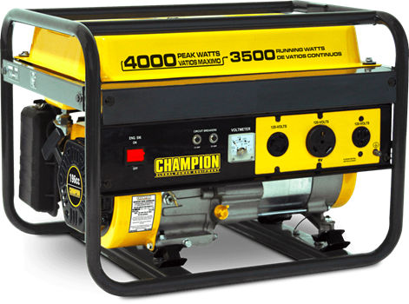
Iterators & Generators
TA: Peter Xu
Credit Eric Pai 11/10/2016
NEXT
NEXT
NEXT
NEXT
NEXT
NEXT
NEXT
NEXT
NEXT
NEXT
NEXT
NEXT
NEXT
NEXT
NEXT
NEXT
NEXT
NEXT
NEXT
NEXT
NEXT

Slide 2
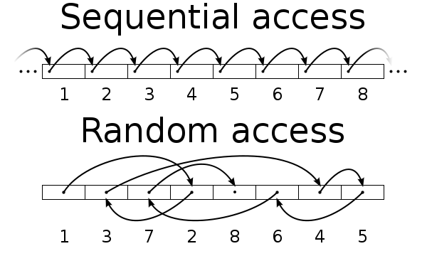
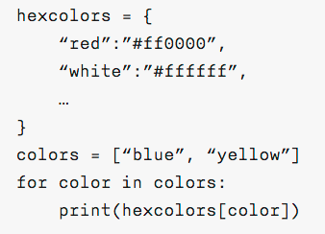
Access Patterns
Sequential Access
Random Access
https://en.wikipedia.org/wiki/Sequential_access#/media/File:Random_vs_sequential_access.svg

Slide 3

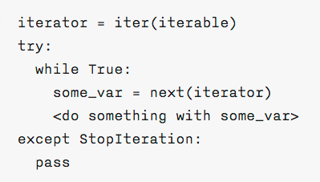
For Loops (Iterables, Iterators)
Notes
iterable - container that can be processed sequentially by calling `iter` to get an iterator.
iterator - object that keeps track of position and returns the next value in the sequence when `next` is called.
Calling next raises a StopIteration if the end of the iterator has been reached.

Slide 4
Iterables
Practically:
1. An object is iterable if it implements either
__iter__() or __getitem__().
2. An object can function as an iterator if it implements next().
http://stackoverflow.com/questions/926574/why-does-defining-getitem-on-a-class-make-it-iterable-in-python
Iterables are fixed representations that can be processed sequentially by calling `iter` to retrieve an iterator
They can either be...
Explicit sequences where values are stored explicitly (e.g. lists, tuples, strings)
Implicit sequences where new values are calculated lazily on demand (e.g. map, filter, generators)

Slide 5
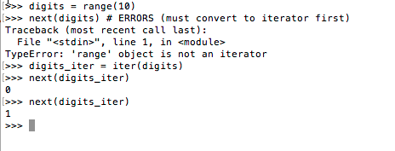
Iterators
Iterators provide sequential access to an iterable
Call the iter on an iterable to get the iterator
Call next to get the next value in the iterator
Iterators store state to return the next value (next is non-pure)

Slide 6
Iterators Illustrated
>>> lst = [1, 2, 3, 4, 5, 6, 7]
1
2
3
4
5
6
7

Slide 7
Iterators Illustrated
i1
>>> lst = [1, 2, 3, 4, 5, 6, 7]
>>> i1 = iter(lst)
1
2
3
4
5
6
7

Slide 8
Iterators Illustrated
i1
>>> lst = [1, 2, 3, 4, 5, 6, 7]
>>> i1 = iter(lst)
>>> i2 = iter(lst)
1
2
3
4
5
6
7
i2

Slide 9
Iterators Illustrated
i1
>>> lst = [1, 2, 3, 4, 5, 6, 7]
>>> i1 = iter(lst)
>>> i2 = iter(lst)
>>> next(i1)
1
2
3
4
5
6
7
i2

Slide 10
Iterators Illustrated
i1
>>> lst = [1, 2, 3, 4, 5, 6, 7]
>>> i1 = iter(lst)
>>> i2 = iter(lst)
>>> next(i1) 1
1
2
3
4
5
6
7
i2

Slide 11
Iterators Illustrated
i1
>>> lst = [1, 2, 3, 4, 5, 6, 7]
>>> i1 = iter(lst)
>>> i2 = iter(lst)
>>> next(i1) 1
>>> lst[0] = 33
1
2
3
4
5
6
7
i2

Slide 12
Iterators Illustrated
i1
>>> lst = [1, 2, 3, 4, 5, 6, 7]
>>> i1 = iter(lst)
>>> i2 = iter(lst)
>>> next(i1) 1
>>> lst[0] = 33
33
2
3
4
5
6
7
i2

Slide 13
Iterators Illustrated
i1
>>> lst = [1, 2, 3, 4, 5, 6, 7]
>>> i1 = iter(lst)
>>> i2 = iter(lst)
>>> next(i1) 1
>>> lst[0] = 33
>>> next(i2)
33
2
3
4
5
6
7
i2

Slide 14
Iterators Illustrated
i1
>>> lst = [1, 2, 3, 4, 5, 6, 7]
>>> i1 = iter(lst)
>>> i2 = iter(lst)
>>> next(i1) 1
>>> lst[0] = 33
>>> next(i2) 33
33
2
3
4
5
6
7
i2

Slide 15
Iterators Illustrated
i1
>>> lst = [1, 2, 3, 4, 5, 6, 7]
>>> i1 = iter(lst)
>>> i2 = iter(lst)
>>> next(i1) 1
>>> lst[0] = 33
>>> next(i2) 33
>>> next(i1)
33
2
3
4
5
6
7
i2

Slide 16
Iterators Illustrated
i1
>>> lst = [1, 2, 3, 4, 5, 6, 7]
>>> i1 = iter(lst)
>>> i2 = iter(lst)
>>> next(i1) 1
>>> lst[0] = 33
>>> next(i2) 33
>>> next(i1) 2
33
2
3
4
5
6
7
i2

Slide 17
Iterators Illustrated
i1
>>> lst = [1, 2, 3, 4, 5, 6, 7]
>>> i1 = iter(lst)
>>> i2 = iter(lst)
>>> next(i1) 1
>>> lst[0] = 33
>>> next(i2) 33
>>> next(i1) 2
>>> next(i1)
33
2
3
4
5
6
7
i2

Slide 18
Iterators Illustrated
i1
>>> lst = [1, 2, 3, 4, 5, 6, 7]
>>> i1 = iter(lst)
>>> i2 = iter(lst)
>>> next(i1) 1
>>> lst[0] = 33
>>> next(i2) 33
>>> next(i1) 2
>>> next(i1) 3
33
2
3
4
5
6
7
i2

Slide 19
Iterators Illustrated
i1
>>> lst = [1, 2, 3, 4, 5, 6, 7]
>>> i1 = iter(lst)
>>> i2 = iter(lst)
>>> next(i1) 1
>>> lst[0] = 33
>>> next(i2) 33
>>> next(i1) 2
>>> next(i1) 3
>>> next(i2)
33
2
3
4
5
6
7
i2

Slide 20
Iterators Illustrated
i1
>>> lst = [1, 2, 3, 4, 5, 6, 7]
>>> i1 = iter(lst)
>>> i2 = iter(lst)
>>> next(i1) 1
>>> lst[0] = 33
>>> next(i2) 33
>>> next(i1) 2
>>> next(i1) 3
>>> next(i2) 2
33
2
3
4
5
6
7
i2

Slide 21
Iterator WWPD
>>> lst = [1, 5, 4, 3]
>>> i = iter(lst)
>>> next(i)
>>> j = iter(lst)
>>> next(j)

Slide 22
Iterator WWPD
>>> lst = [1, 5, 4, 3]
>>> i = iter(lst)
>>> next(i)
>>> 1
>>> j = iter(lst)
>>> next(j)
>>> 1

Slide 23
Iterator WWPD
>>> lst = [1, 2, 3, 4, 5]
>>> i = iter(lst)
>>> next(i)
>>> next(i)
>>> for _ in range(len(lst)):
print(next(i))

Slide 24
Iterator WWPD
>>> lst = [1, 2, 3, 4, 5]
>>> i = iter(lst)
>>> next(i)
>>> next(i)
>>> for _ in range(len(lst)):
print(next(i))
>>> 3
>>> 4
>>> 5
>>> Error (StopIteration)

Slide 25
Iterator WWPD
>>> obj = SomeObj()
>>> i = iter(obj)
>>> next(obj)
Credit: http://albertwu.org/cs61a/review/iterators/basic.html

Slide 26
Iterator WWPD
>>> obj = SomeObj()
>>> i = iter(obj)
>>> next(obj)
Error. Obj is not necessarily an iterator. Call next on i instead.
Credit: http://albertwu.org/cs61a/review/iterators/basic.html

Slide 27
Iterator WWPD
>>> lst = [1, 2, 3, 4, 5]
>>> x = iter(lst)
>>> y = iter(lst)
>>> next(x)
>>> for i in range(len(lst) - 1):
lst[i] = next(x)
>>> lst[len(lst) - 1] = next(y)
>>> print(lst)

Slide 28
Iterator WWPD
>>> lst = [1, 2, 3, 4, 5]
>>> x = iter(lst)
>>> y = iter(lst)
>>> next(x)
>>> for i in range(len(lst) - 1):
lst[i] = next(x)
>>> lst[len(lst) - 1] = next(y)
>>> print(lst)
>>> [2, 3, 4, 5, 2]

Slide 29
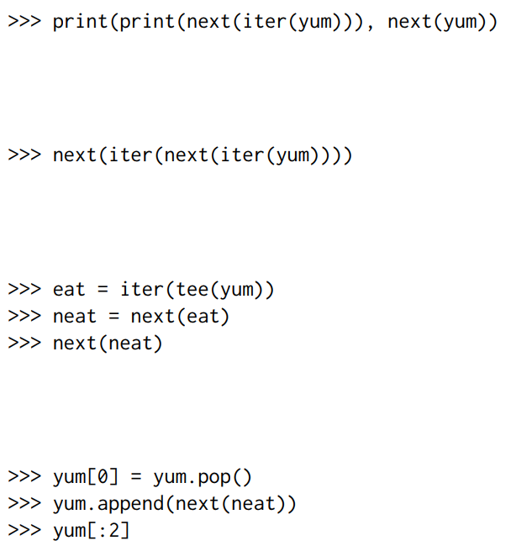
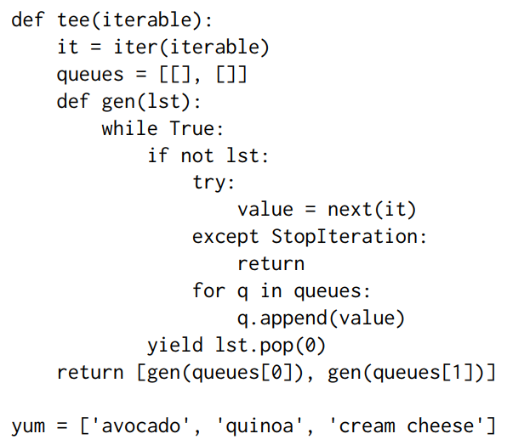
Exam-level Termin(iter)ator (summer 17 final Q1)
What would Python Display?

Slide 30
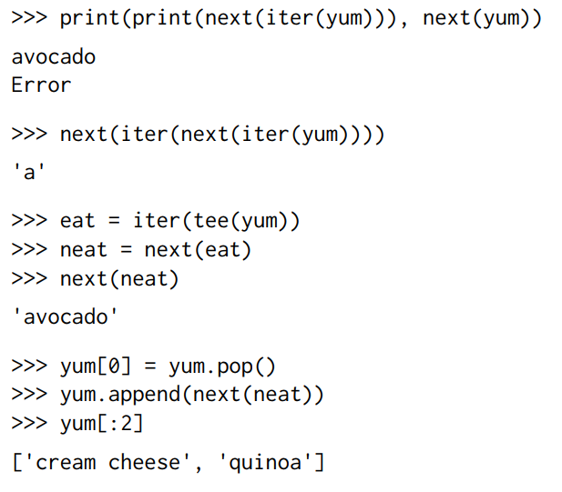
Exam-level Termin(iter)ator solution
What would Python Display?

Slide 31
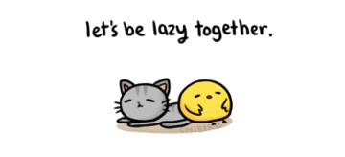
Lazy Computation
Key Insight: Values can be computed on demand instead of being explicitly stored. This process of delaying computation is called lazy computation
Today we’ll explore one kind of lazy computation: generators
http://chibird.com/post/41911307802/yay-laziness-i-should-really-not-be-celebrating

Slide 32
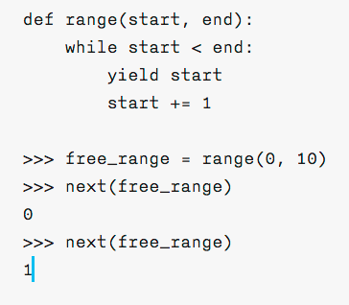
Generator & Generator Functions
Generator Functions are functions that return a generator (a type of iterator) when they are called.
Functions are considered generator functions if they contain a yield in the body.
A loop is a common structure in a generator function. Otherwise your generator won’t generate very much.
Generator functions return iterators!
(no need to
call `iter`)

Slide 33
Generator Behavior
Generator Function
Calling the generator function returns a generator object.
First next call to generator object
Start at the top of the generator function body.
Run until immediately after the first yield encountered.
Return the value in the yield line.
Save start position at line following yield.
Subsequent next calls to generator object
Start at previous start position.
Run until immediately after the first yield encountered.
Return the value in the yield line.
Save start position at line following yield.
Stops when no more yield statements left to call.
Generator Object

Slide 34
Generators Illustrated
def gen(x):
while(x > 0):
yield x
x -= 1
yield x - 1
print(“much”)
yield x * 2
print(“wow”)

Slide 35
Generators Illustrated
>>> a = gen(2)
def gen(x):
while(x > 0):
yield x
x -= 1
yield x - 1
print(“much”)
yield x * 2
print(“wow”)

Slide 36
Generators Illustrated
x tracker: 2
>>> a = gen(2) <generator object gen…>
def gen(x):
while(x > 0):
yield x
x -= 1
yield x - 1
print(“much”)
yield x * 2
print(“wow”)

Slide 37
Generators Illustrated
x tracker: 2
>>> a = gen(2) <generator object gen…>
>>> next(a)
def gen(x):
while(x > 0):
yield x
x -= 1
yield x - 1
print(“much”)
yield x * 2
print(“wow”)

Slide 38
Generators Illustrated
x tracker: 2
>>> a = gen(2) <generator object gen…>
>>> next(a) 2
def gen(x):
while(x > 0):
yield x
x -= 1
yield x - 1
print(“much”)
yield x * 2
print(“wow”)

Slide 39
Generators Illustrated
x tracker: 2
>>> a = gen(2) <generator object gen…>
>>> next(a) 2
>>> next(a)
def gen(x):
while(x > 0):
yield x
x -= 1
yield x - 1
print(“much”)
yield x * 2
print(“wow”)

Slide 40
Generators Illustrated
x tracker: 1
>>> a = gen(2) <generator object gen…>
>>> next(a) 2
>>> next(a) 0
def gen(x):
while(x > 0):
yield x
x -= 1
yield x - 1
print(“much”)
yield x * 2
print(“wow”)

Slide 41
Generators Illustrated
x tracker: 1
>>> a = gen(2) <generator object gen…>
>>> next(a) 2
>>> next(a) 0
>>> next(a)
def gen(x):
while(x > 0):
yield x
x -= 1
yield x - 1
print(“much”)
yield x * 2
print(“wow”)

Slide 42
Generators Illustrated
x tracker: 1
>>> a = gen(2) <generator object gen…>
>>> next(a) 2
>>> next(a) 0
>>> next(a)
much
2
def gen(x):
while(x > 0):
yield x
x -= 1
yield x - 1
print(“much”)
yield x * 2
print(“wow”)

Slide 43
Generators Illustrated
x tracker: 1
>>> a = gen(2) <generator object gen…>
>>> next(a) 2
>>> next(a) 0
>>> next(a)
much
2
>>> next(a)
def gen(x):
while(x > 0):
yield x
x -= 1
yield x - 1
print(“much”)
yield x * 2
print(“wow”)

Slide 44
Generators Illustrated
x tracker: 1
>>> a = gen(2) <generator object gen…>
>>> next(a) 2
>>> next(a) 0
>>> next(a)
much
2
>>> next(a)
wow
1
def gen(x):
while(x > 0):
yield x
x -= 1
yield x - 1
print(“much”)
yield x * 2
print(“wow”)

Slide 45
Generators Illustrated
x tracker: 1
>>> a = gen(2) <generator object gen…>
>>> next(a) 2
>>> next(a) 0
>>> next(a)
much
2
>>> next(a)
wow
1
>>> next(a)
def gen(x):
while(x > 0):
yield x
x -= 1
yield x - 1
print(“much”)
yield x * 2
print(“wow”)

Slide 46
Generators Illustrated
x tracker: 0
>>> a = gen(2) <generator object gen…>
>>> next(a) 2
>>> next(a) 0
>>> next(a)
much
2
>>> next(a)
wow
1
>>> next(a) -1
def gen(x):
while(x > 0):
yield x
x -= 1
yield x - 1
print(“much”)
yield x * 2
print(“wow”)

Slide 47
Generators Illustrated
x tracker: 0
>>> a = gen(2) <generator object gen…>
>>> next(a) 2
>>> next(a) 0
>>> next(a)
much
2
>>> next(a)
wow
1
>>> next(a) -1
>>> next(a)
def gen(x):
while(x > 0):
yield x
x -= 1
yield x - 1
print(“much”)
yield x * 2
print(“wow”)

Slide 48
Generators Illustrated
x tracker: 0
>>> a = gen(2) <generator object gen…>
>>> next(a) 2
>>> next(a) 0
>>> next(a)
much
2
>>> next(a)
wow
1
>>> next(a) -1
>>> next(a)
much
0
def gen(x):
while(x > 0):
yield x
x -= 1
yield x - 1
print(“much”)
yield x * 2
print(“wow”)

Slide 49
Generators Illustrated
x tracker: 0
>>> a = gen(2) <generator object gen…>
>>> next(a) 2
>>> next(a) 0
>>> next(a)
much
2
>>> next(a)
wow
1
>>> next(a) -1
>>> next(a)
much
0
>>> next(a)
def gen(x):
while(x > 0):
yield x
x -= 1
yield x - 1
print(“much”)
yield x * 2
print(“wow”)

Slide 50
Generators Illustrated
x tracker: 0
>>> a = gen(2) <generator object gen…>
>>> next(a) 2
>>> next(a) 0
>>> next(a)
much
2
>>> next(a)
wow
1
>>> next(a) -1
>>> next(a)
much
0
>>> next(a)
wow
StopIteration
def gen(x):
while(x > 0):
yield x
x -= 1
yield x - 1
print(“much”)
yield x * 2
print(“wow”)

Slide 51
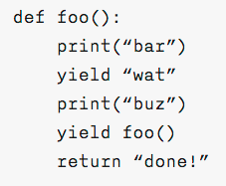
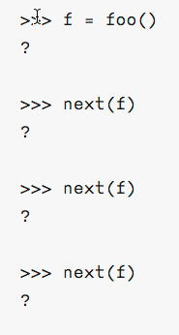
Generator WWPD
WWPD?
Write `nothing` if nothing is output, and `generator` if a generator object is output

Slide 52
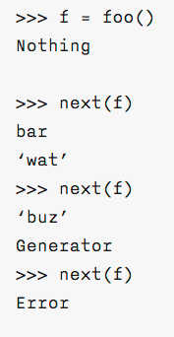
Generator WWPD
WWPD?
Write `nothing` if nothing is output, `generator` if a generator object is output, and `Error` if an error occurs
Return results in StopIteration. The value is not returned.

Slide 53
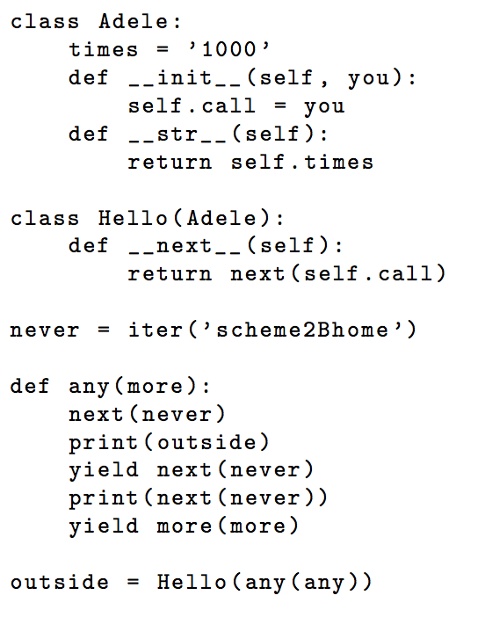
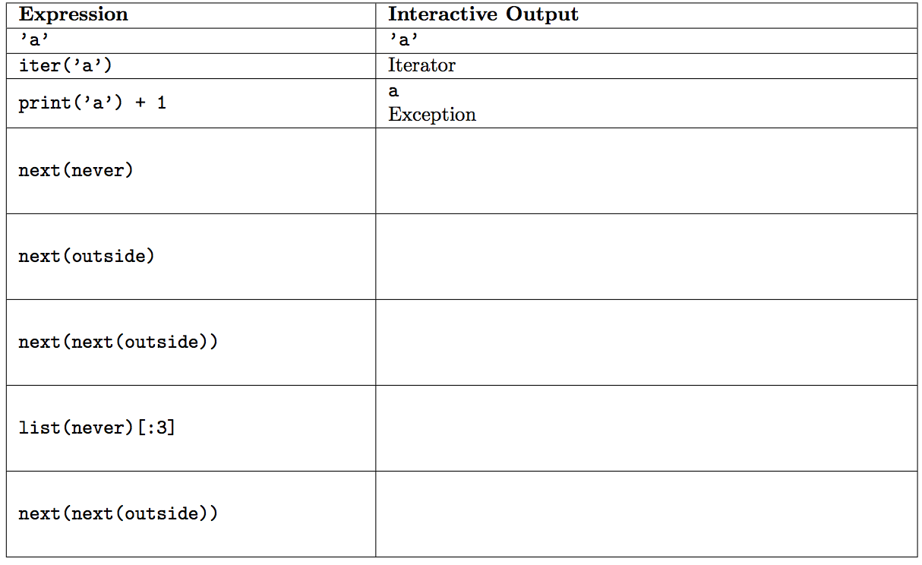
Generator WWPD - Extra Spicy Edition (fa15)

Slide 54
Generator WWPD - Extra Spicy Edition (fa15)
‘s’
1000
‘h’
e
1000
‘e’
[‘2’, ‘B’, ‘h’]
Exception

Slide 55
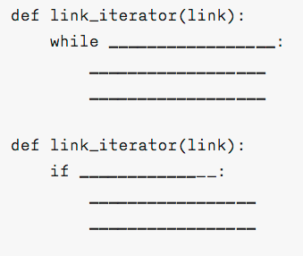
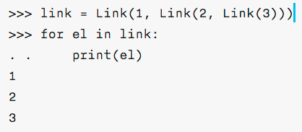
Generators - Practice
Write a generator function `link_iterator` that takes in a linked list and returns a generator over all values in the linked list (assume Link class has no __getitem__ or __len__ defined)
link_iterator(link):

Slide 56
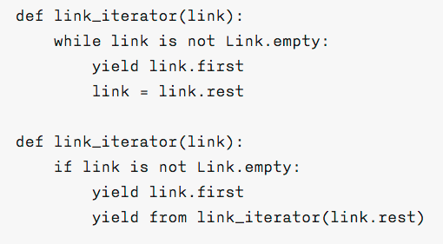
Generators - Practice (solutions)
Write a generator function `link_iterator` that takes in a linked list and returns a generator over all values in the linked list (assume Link class has no __getitem__ or __len__ defined)

Slide 57
Generators - Practice Part 2: The Generating
Write a generator function that produces a generator of the hailstone sequence.
Takes in a number n
If n is even, divide it by 2.
If n is odd, multiply it by 3 and add 1.
If n is 1, return n.

Slide 58
Generators - Practice Part 2: The Generating
Write a generator function that produces a generator of the hailstone sequence.
def hailstone(x):
yield x
while x != 1:
if x % 2 == 0:
x /= 2
else:
x = x * 3 + 1
yield x

Slide 59
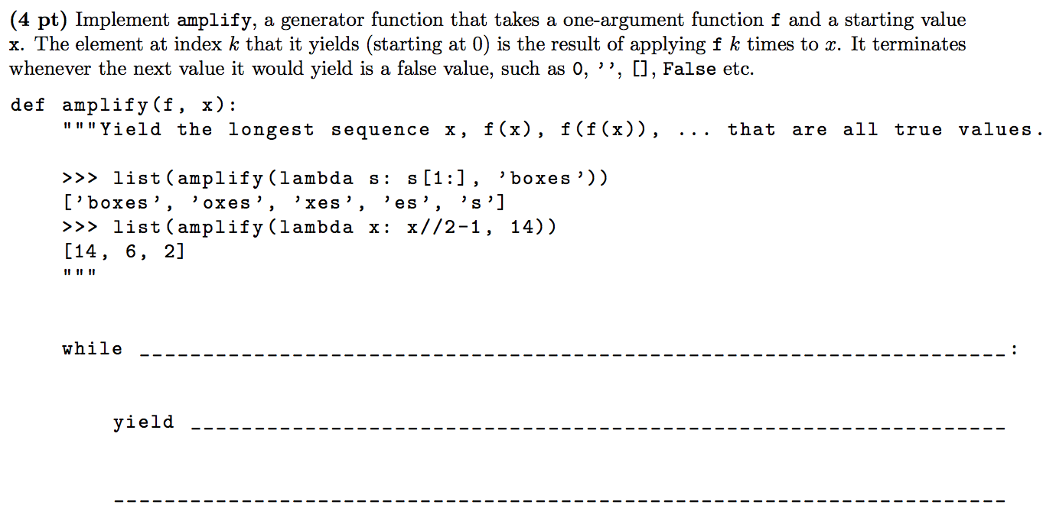
Generators - Practice Part 3: Generational Boogaloo
Credit: Spring 15 Final

Slide 60
Generators - Practice Part 3: Generational Boogaloo
Credit: Spring 15 Final
x
x
x = f(x)

Slide 61
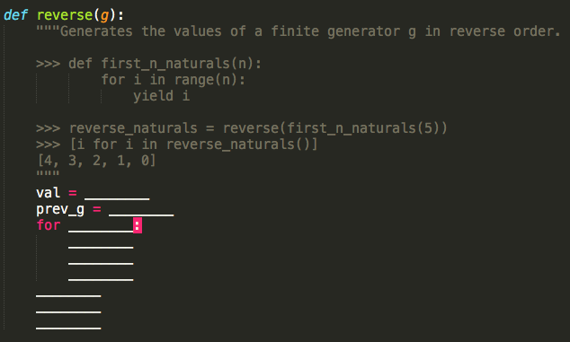
Generators - Practice Part 4: Generated Chemistry
Note: You may not need all lines.

Slide 62
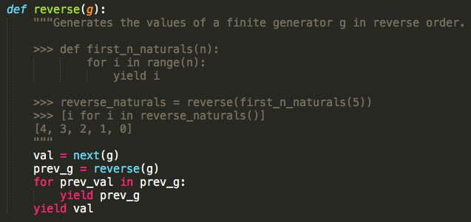
Generators - Practice Part 4: Generated Chemistry
Note: You may not need all lines.

Slide 63
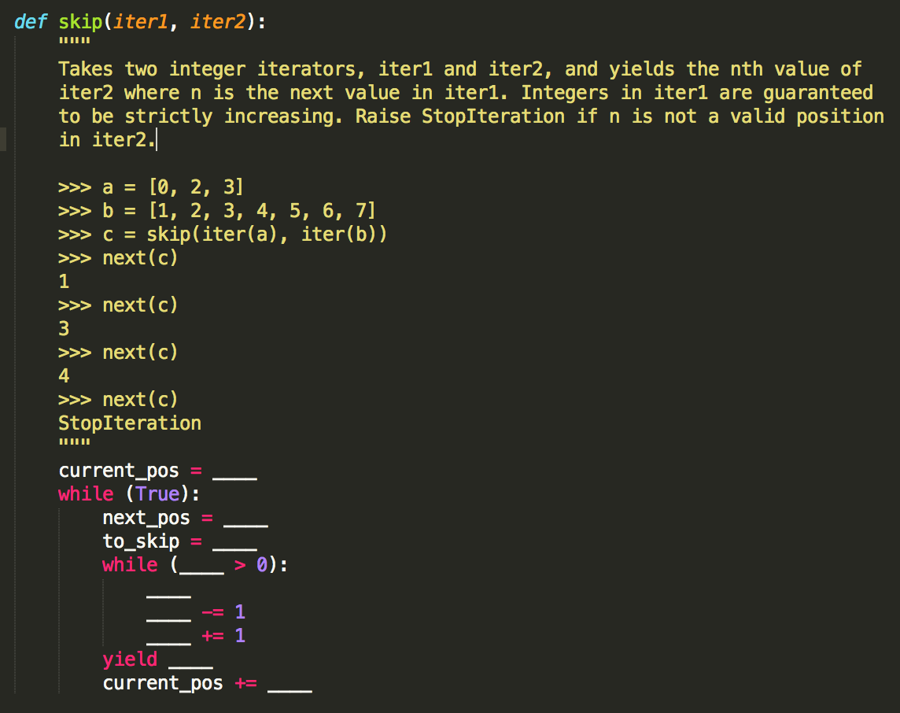
Generators - Practice Part 5: The Good, the Bad, and the Generated

Slide 64
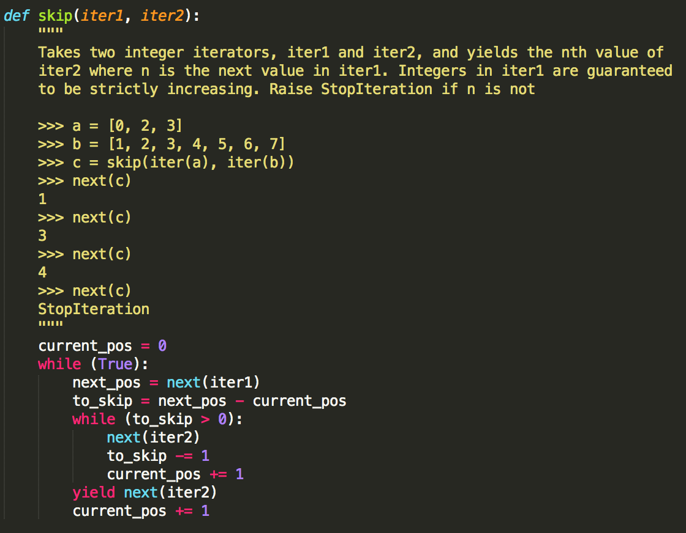
Generators - Practice Part 5: The Good, the Bad, and the Generated

Slide 65
Questions?

Slide 66

Thanks for coming and good luck!
code right, daddy
code right, daddy

Slide 67
code right, daddy

